Slide 1
Direct Marketing Campaign
Prediction model project using KDD CUP 1998 data.
-Saurav Anand

Slide 2
Business Goals
Maximise the net amount of money that would be collected through a direct mail activity
Creating a combination of classification and regression model to predict the potential people whom we can send the mail.
Use Python to perform all the relevant steps of data loading, pre-processing , feature engineering, model building and tuning

Slide 3
PARALYZED VETERANS OF AMERICA (PVA)
This company was established in the 1946 with the goals of serving the needs of the disabled veterans.
Wikipedia link :-https://en.wikipedia.org/wiki/Paralyzed_Veterans_of_America
Official Website :- https://pva.org/

Slide 4
Dataset
There are two dataset provided "cup98LRN.txt“( training data) and "cup98VAL.txt“(test data) where both have more than 95K records and around 481 features.
The Data includes geolocation, occupation, income status, gender , relationship status and much more relevant information in details.
The target columns for classification and regression problems are TARGET_B and TARGET_D respectively

Slide 5
Removing features
Features which has less business impact like "ZIP", "CONTROLN", "TCODE","ODATEDW“ are removed.
Removing Features with high cardinality ( unique count >20)
a) 'OSOURCE', 'STATE', 'MDMAUD’, 'CLUSTER’, 'RFA_3', 'RFA_4', 'RFA_5’, 'RFA_6’, 'RFA_7’, 'RFA_8', 'RFA_9’, 'RFA_10', 'RFA_11', 'RFA_12’, 'RFA_13’, 'RFA_14', 'RFA_15', 'RFA_16', 'RFA_17’, 'RFA_18', 'RFA_19', 'RFA_20', 'RFA_21’, 'RFA_22’, 'RFA_23', 'RFA_24‘ are removed.
b) Reducing the dimensionality of the data.
c) Avoid Excessive use of memory.
d) Simplifying the feature space by removing high cardinality features can improve interpretability

Slide 6
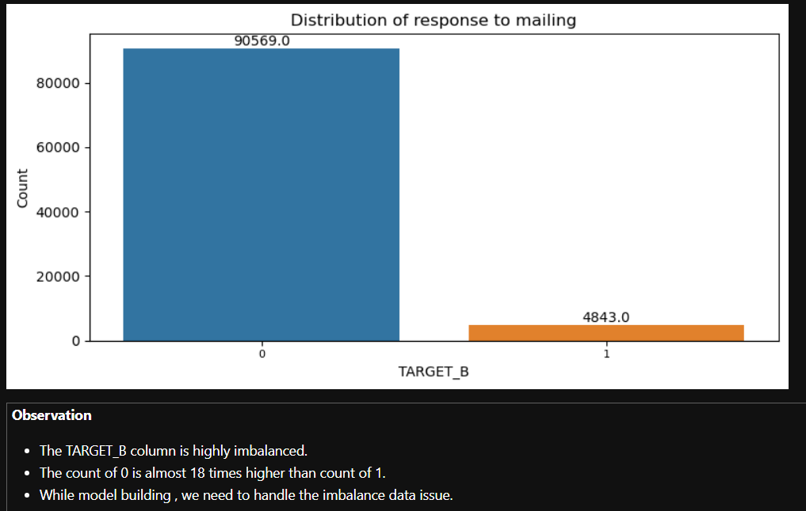
TARGET_B Analysis

Slide 7
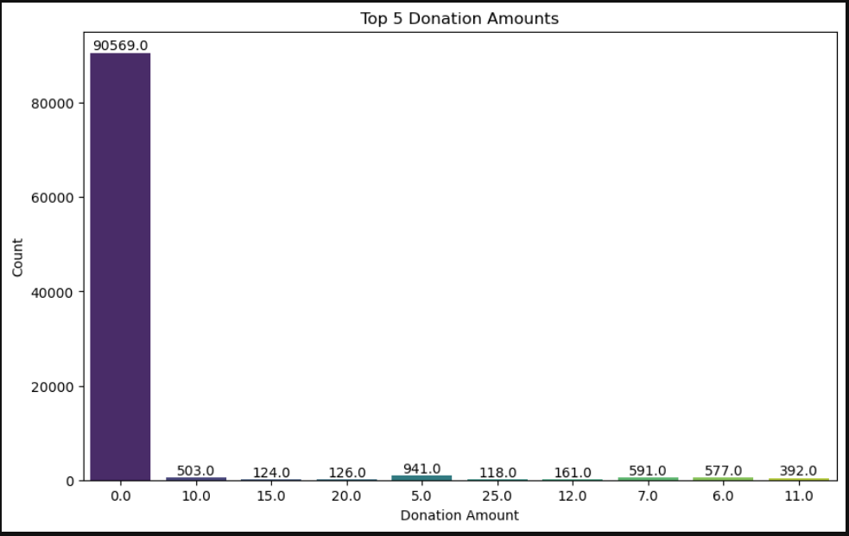
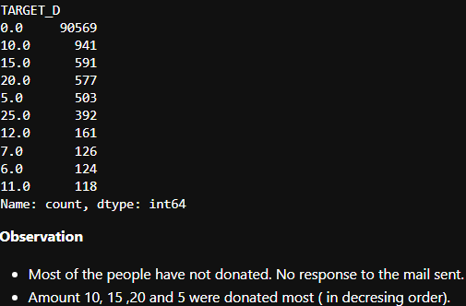
Analysis of TARGET_D

Slide 8
Missing Values
There are lot of columns with the missing values for both categorical and numerical columns.
These are the columns Age, NUMCHLD, INCOME, WEALTH1, MBCRAFT,MBGARDEN,MBBOOKS,MBCOLECT,MAGFAML,MAGFEM,MAGMALE,PUBGARDN,PUBCULIN,PUBHLTH,PUBDOITY,PUBNEWFN,PUBPHOTO,PUBOPP, WEALTH2,MSA,ADI,DMA, ADATE_3 to ADATE_24 , NEXTDATE and TIMELAG
RDATE columns have more than 90 percent of the missing data
RAMNT columns have more than 85% of the missing data
A_DATE columns have high percentage of missing data, some of them are as high as 70 %.
Dropping the columns with the high percentage of missing values.

Slide 9
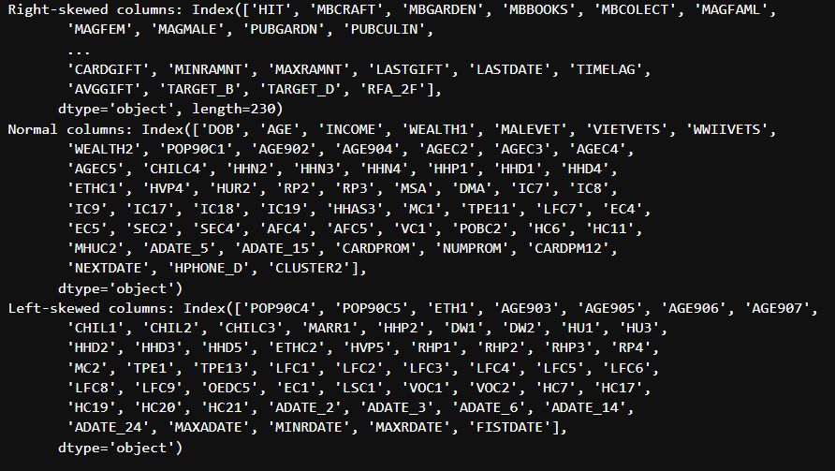
Descriptive Statistics
After the calculation of the five point summary , we got the idea about the distribution of the data
Most of the data are right skewed

Slide 10
Data Quality Issues
There are lot of columns where blank values are present and they refer to a category like in MAILCODE, NOEXCH etc.
There are blank values nut they need to be replaced with value N ( which refers to N )
Gender takes 4 values. Male, Female, Unknown and A. The A value is a mistake as it takes one (1) value. It will be replaced accordingly.
Age column has value 0 which doesn’t make sense.
For numerical columns , I have replaced the null values with the mean.

Slide 11
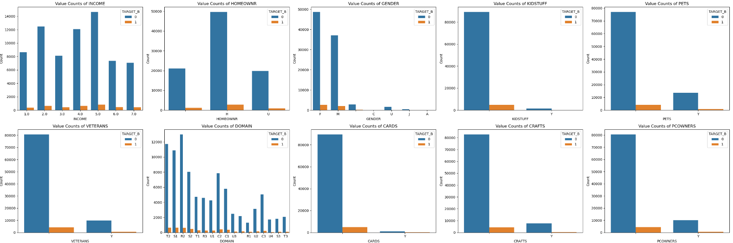
Relationship between input and TARGET_B

Slide 12
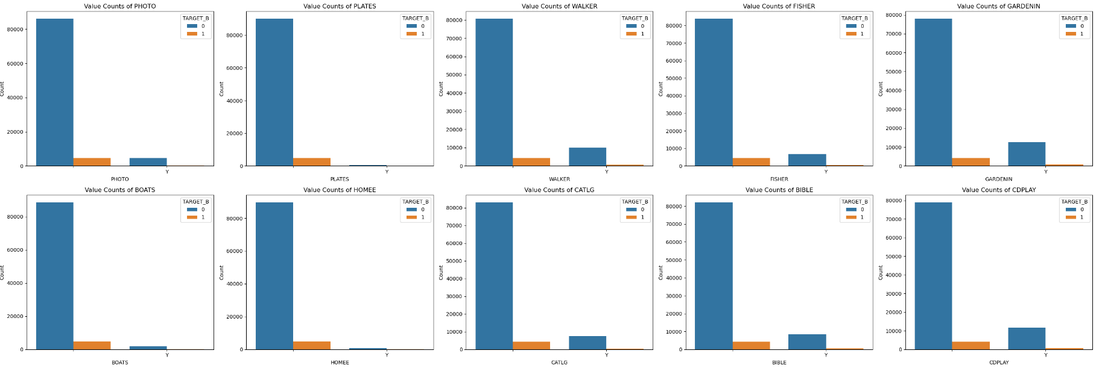
Relationship between input and TARGET_B (continued)

Slide 13
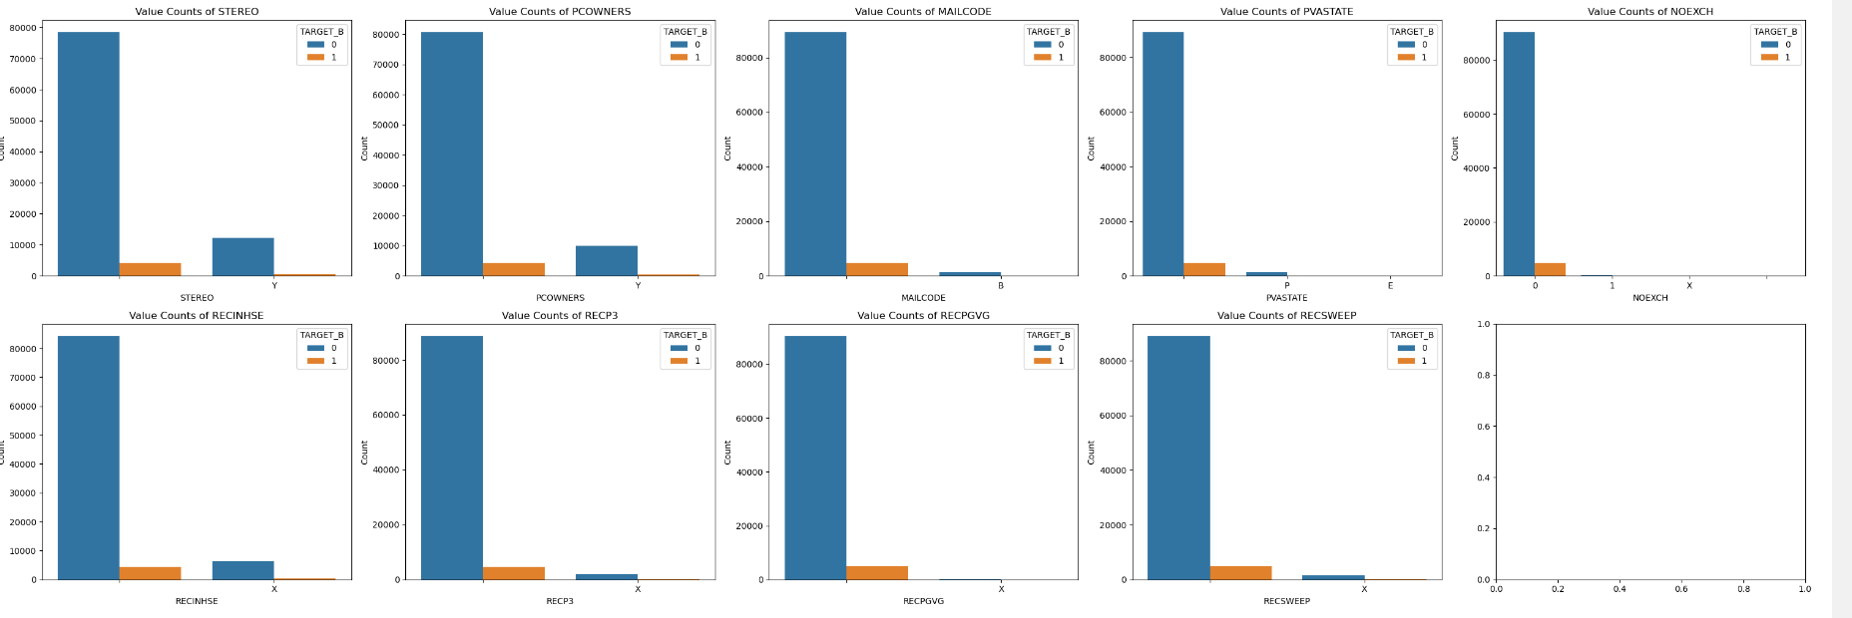
Relationship between input and TARGET_B (continued)

Slide 14
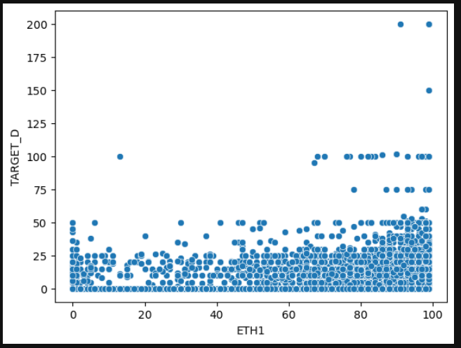
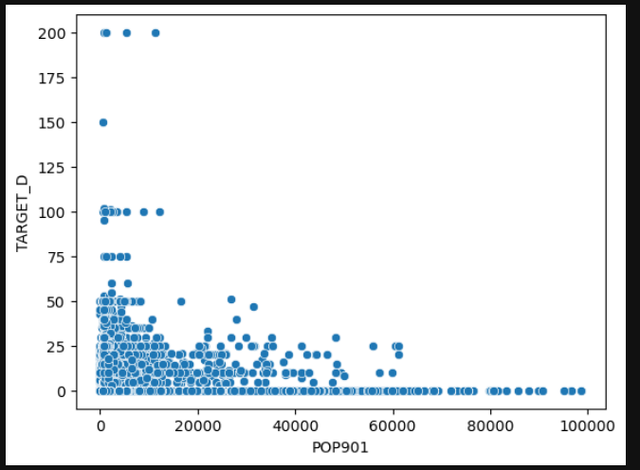
Analysis of some numerical columns with donation amount (TARGET_D)

Slide 15
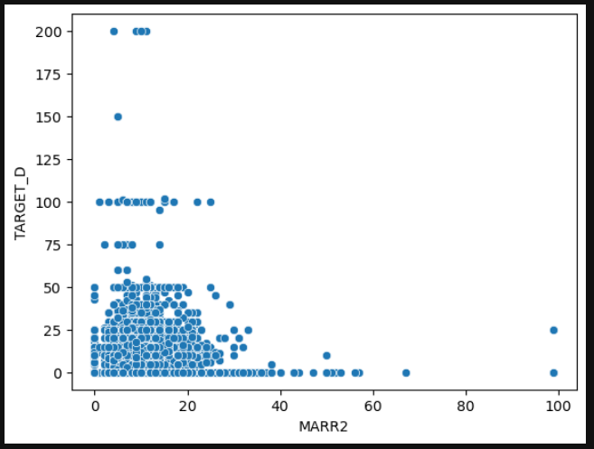
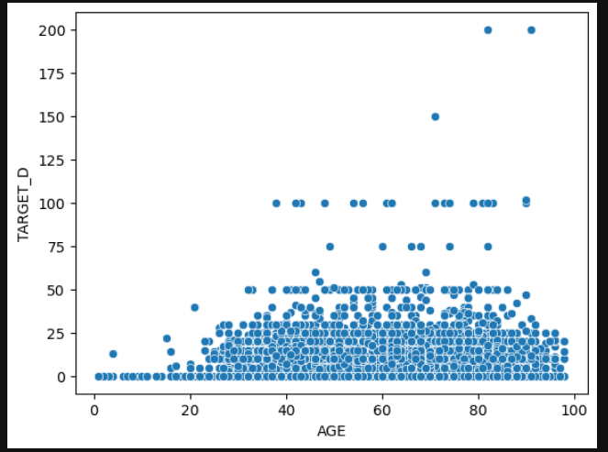
Analysis of some numerical columns with donation amount (TARGET_D) continued..

Slide 16
Variance Threshold technique to remove constant features
Numerical columns with constant values ADATE_5 and ADATE_15
Numerical columns with quasi constant ( threshold = 0.01 ) which means it will find columns with 99 % same data. The columns are 'PUBPHOTO','ADATE_2','ADATE_3','ADATE_5','ADATE_6','ADATE_14','ADATE_15','ADATE_20','ADATE_24
Categorical columns with constant value RFA_2R
Numerical columns with quasi constant ( threshold = 0.01 ) are 'NOEXCH', 'RECPGVG', 'MAJOR', 'HOMEE', 'PLATES', 'RFA_2R‘.
All these constant features were dropped from the dataset.

Slide 17
Chi-Square Test
This test was performed to find the relationship between categorical input features and the TARGET_B
After finding the relationship , we used the SelectKBest to get the top 10 categorical features which are strongly related to the TARGET_B.
The top 10 features were 'RECINHSE', 'RECP3', 'SOLIH', 'GEOCODE', 'GARDENIN', 'WALKER', 'LIFESRC', 'PEPSTRFL', 'RFA_2', 'RFA_2A

Slide 18
Kendall rank correlation
Kendall rank statistical test is chosen because of the following reasons:-
relationship between the variables where target is categorical and input features is numerical
robust to outliers
not assume any specific distribution of the data( non- parametric test).
Top 30 features were selected which showed high correlation with the target.

Slide 19
Model Building Classification
We have already reduced the number of features in the dataset
Now our challenge is that the TARGET_B is highly imbalanced
Class 0 -> 95 % of the data
Class 1 -> 5% of the data
Our model of choice will be boosting algorithms like Xgboost, LightGBM and Catboost

Slide 20
scale_pos_weight hyperparameter
All the three algorithm uses the scale_pos_weight parameter for handling the imbalance class. These are the characteristics of this hyper parameter.
scale_pos_weight is 1 by default.
Both major class and minority class get the same weight- scale_pos_weight = total_majority_examples / total_minority_examples.
In our dataset
no of negative values :- 90569
no of positive values :- 4843
scale_pos_weight = 90669/4843 = 18.7 ( 19 )

Slide 21
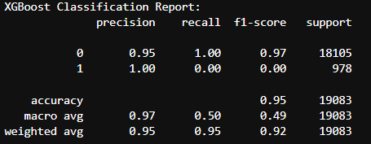
Xgboost with default scale_pos_weight (GridSearch)
We got the following results :-

Slide 22
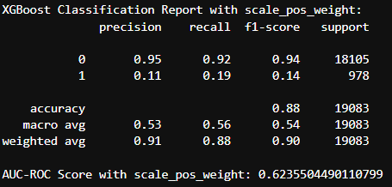
Xgboost with Optuna tuned Hyperparameters ( scale_pos_weight': 12)
Mathematically , the scale_pos_weight should be 19 (checking with values close to it) .
Optuna is used for hyperparameter , which gives scale_pos_weight as 12.
Best parameters after tuning

Slide 23
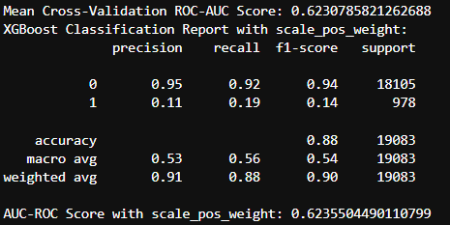
Xgboost with Optuna tuned Hyperparameters with 10 CV

Slide 24
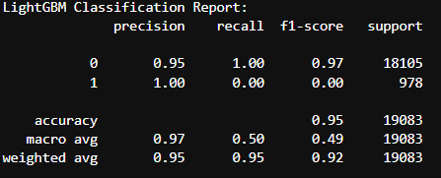
LGBM with default scale_pos_weight

Slide 25
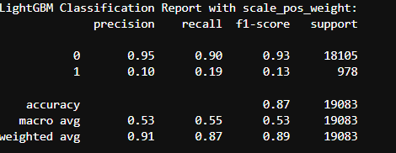
LightGBM with Optuna Hyperparameters (scaled_pos_weight =12)
Best hyperparameters: {'boosting_type': 'dart', 'lambda_l1': 0.0007471005101563267, 'lambda_l2': 0.013891035449242169, 'num_leaves': 85, 'max_depth': 3, 'learning_rate': 0.05785019188245648, 'min_child_samples': 37, 'subsample': 0.685574858321353, 'colsample_bytree': 0.9454764722329667, 'n_estimators': 848, 'scale_pos_weight': 12, 'min_split_gain': 1.1829091438181025e-06, 'cat_smooth': 2.841266138545274e-08, 'cat_l2': 0.06162920478153111}

Slide 26
Model Selection
Xgboost Optuna tuned model is selected for the prediction for the test set.
This model has better roc_auc curve than others.
All the methods performed pretty average.
With better Feature engineering and experimenting with other models can improve the results more.

Slide 27
Next Steps
With the help of the classifier model, predictions is made to check which persons have donated on the test data .
Please note that we need to pre-process the test data exactly same as the train data.
This data will be filtered.
Then on the filtered data, we will use the regression model to check the donated money.

Slide 28
Prediction on the test data
The Output column predicted for the test data is named as IsDonated.
The IsDonated column has the following value count
- class 0 -> 87926 ( people not donated)
- class 1 -> 8441 ( people who have donated)
We have to target the 8441 people who have donated and have to predict how much amount they have predicted ( regression problem).

Slide 29
Data Preparation for the Regression task
We will be using the same cleaned train_df dataset ( selected features) used for the classification problem.
We have the filtered data with people who have donated the amount.
Dropped the TARGET_B column from the training data.
Used the Xgboost regressor algorithm with the same parameters used for classification.
Preprocessed the test_df data similar to train_df to get the predictions.
Here the predictions were stored as "Predicted_AMOUNT_Donated"

Slide 30
Descriptive statistics of the predicted amount
count 8441.000000 ( Total no of people who donated )
mean 14.302376 ( Average amount donated)
std 5.383672 ( Standard deviation )
min 5.231349
25% 12.918017
50% 13.427476
75% 14.421945
max 140.110321
Total_predicted_donations = 120706.3

Slide 31
Optimizing Envelope strategy
Donation Stats & Costs: Define donation stats (mean, standard deviation) and envelope costs ($5 and $1).
Simulated Donations: Generate simulated donations based on defined statistics.
Profit Calculation: Calculated profit by summing donations and deducting envelope costs.
Iterative Optimization: Adjusted the target numbers for each envelope iteratively to maximize profit.
Results: Printed the optimal numbers and maximum achieved profit.

Slide 32

Optimizing Envelope strategy continued

Slide 33
Further Improvements
More in-depth analysis of data to improve the quality related to missing values
Experimenting with different feature selection technique
Testing with other models or blending the boosting models with appropriate weights
The above approach will definitely improve the overall performance of the code

Slide 34
Questions ?

